Slide 1
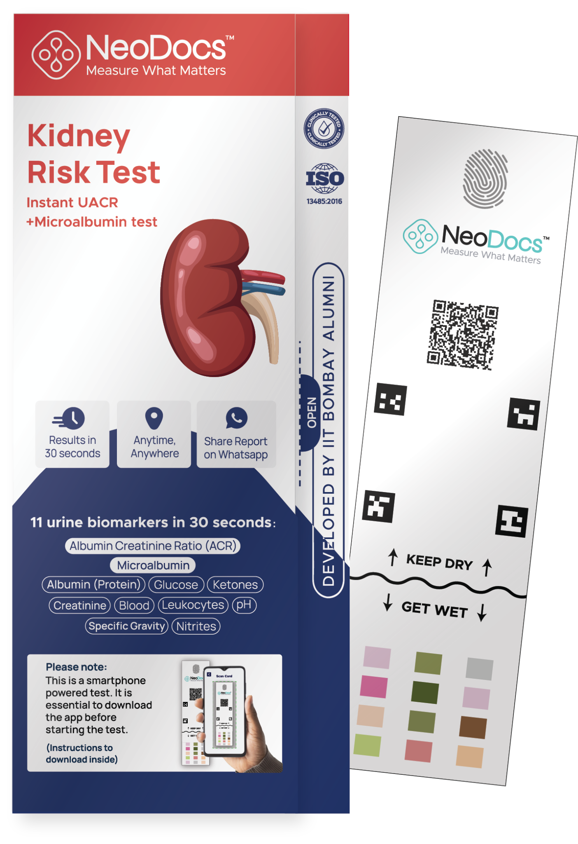



MONTHLY UPDATE - UACR CAMPS
Instant UACR on any phone
In-clinic + At-home

Slide 2
Overview (till 2nd July 2025)
Total Tests | 14050
Total Doctors (Who conducted testing) | 741
Total Camps | 3063
A2+A3 Abnormality | 33%
States Covered | 26

Slide 3
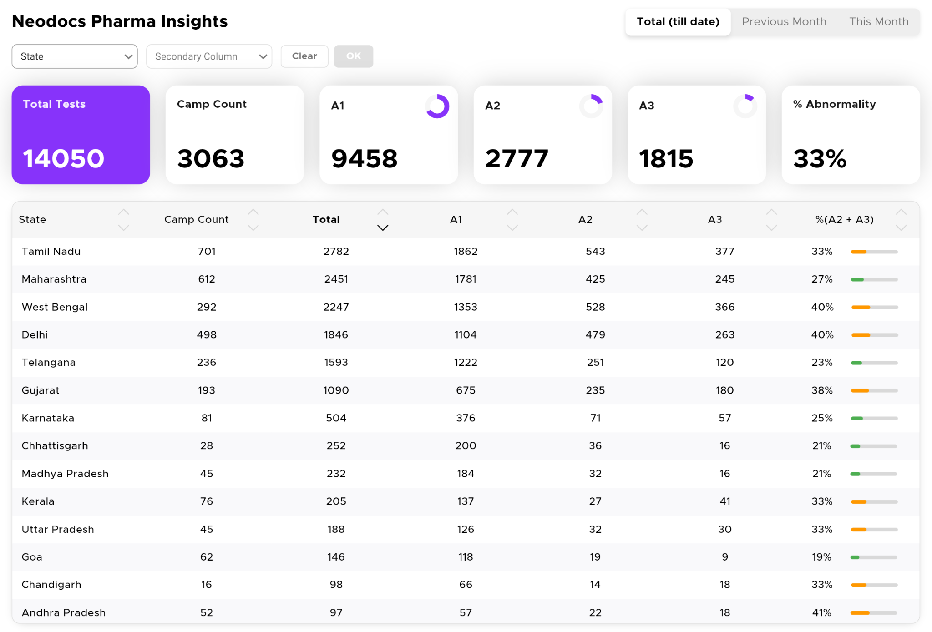
State Wise Testing (till 2nd July 2025)

Slide 4
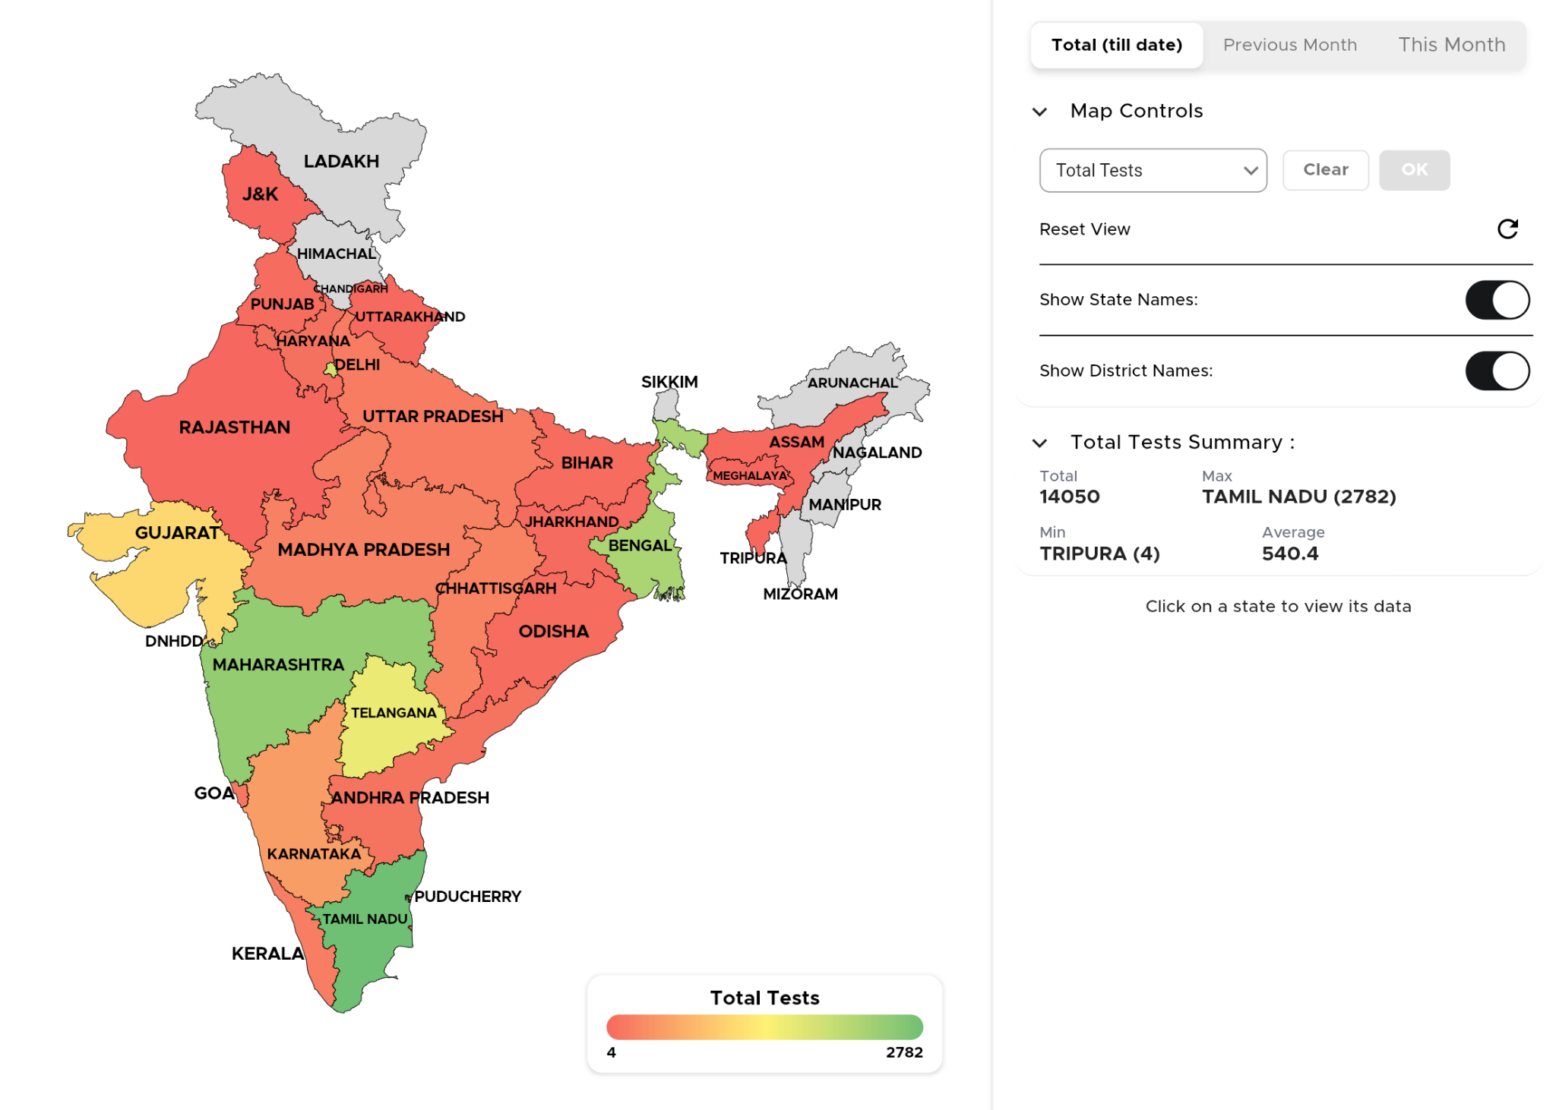
Map view overall insights (till 2nd July 2025)

Slide 5
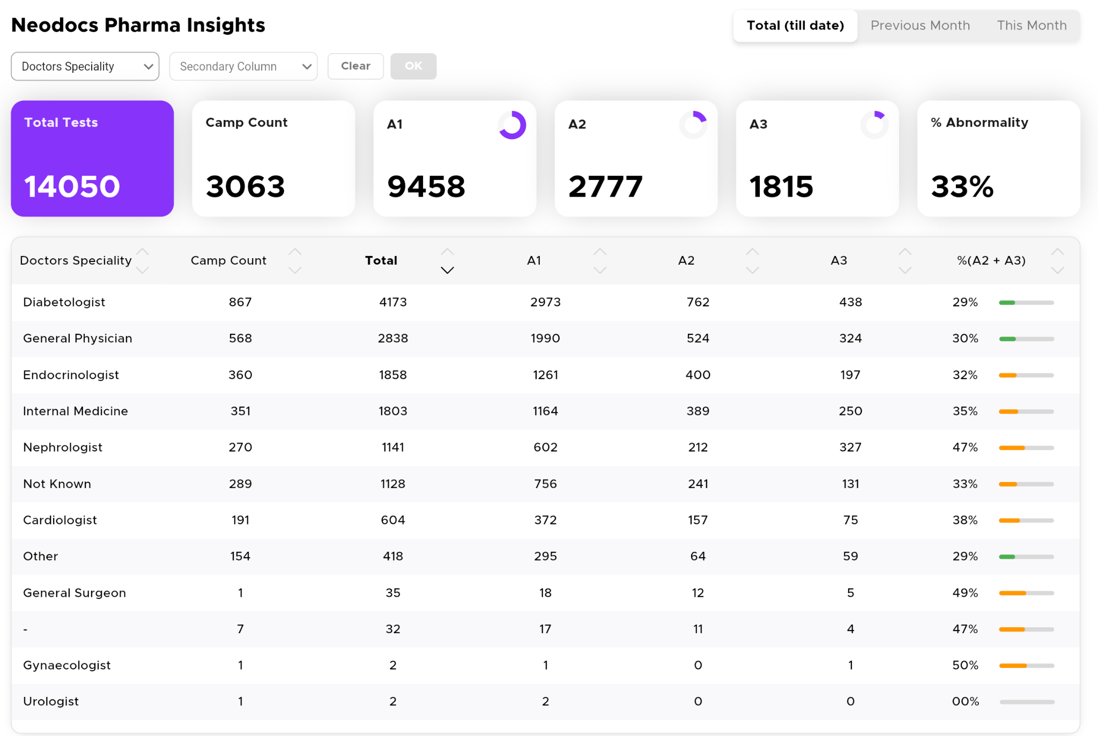
Specialty Wise insights (till 2nd July 2025)

Slide 6
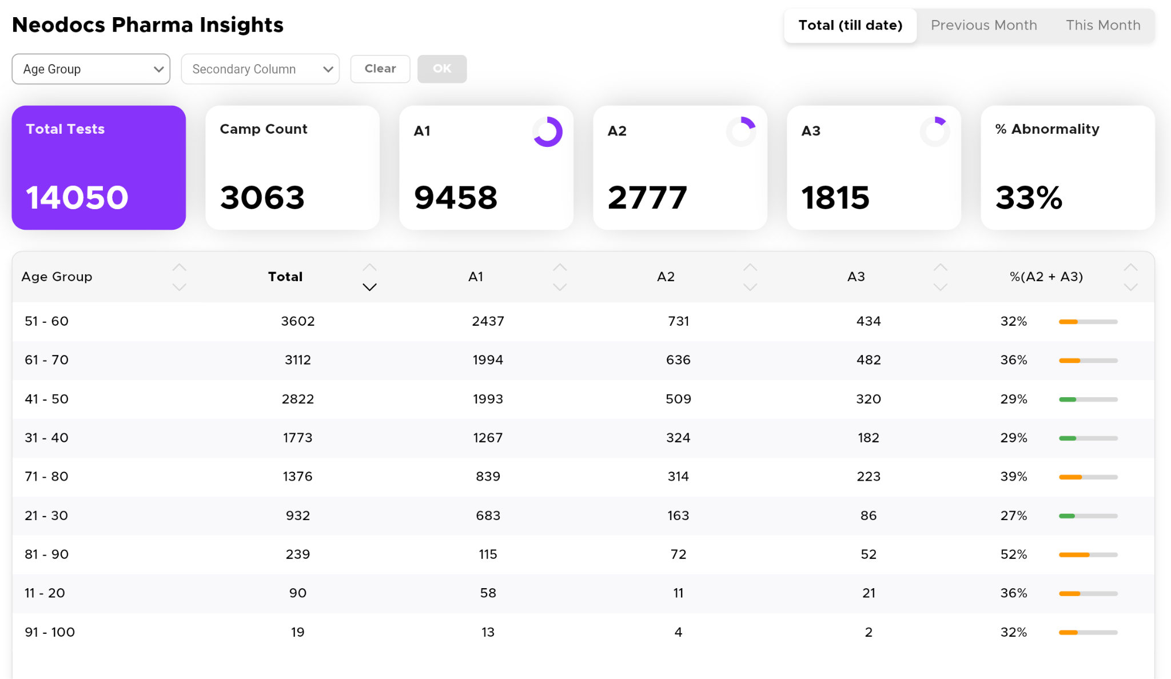
Age Wise Overall insights (till 2nd July 2025)

Slide 7
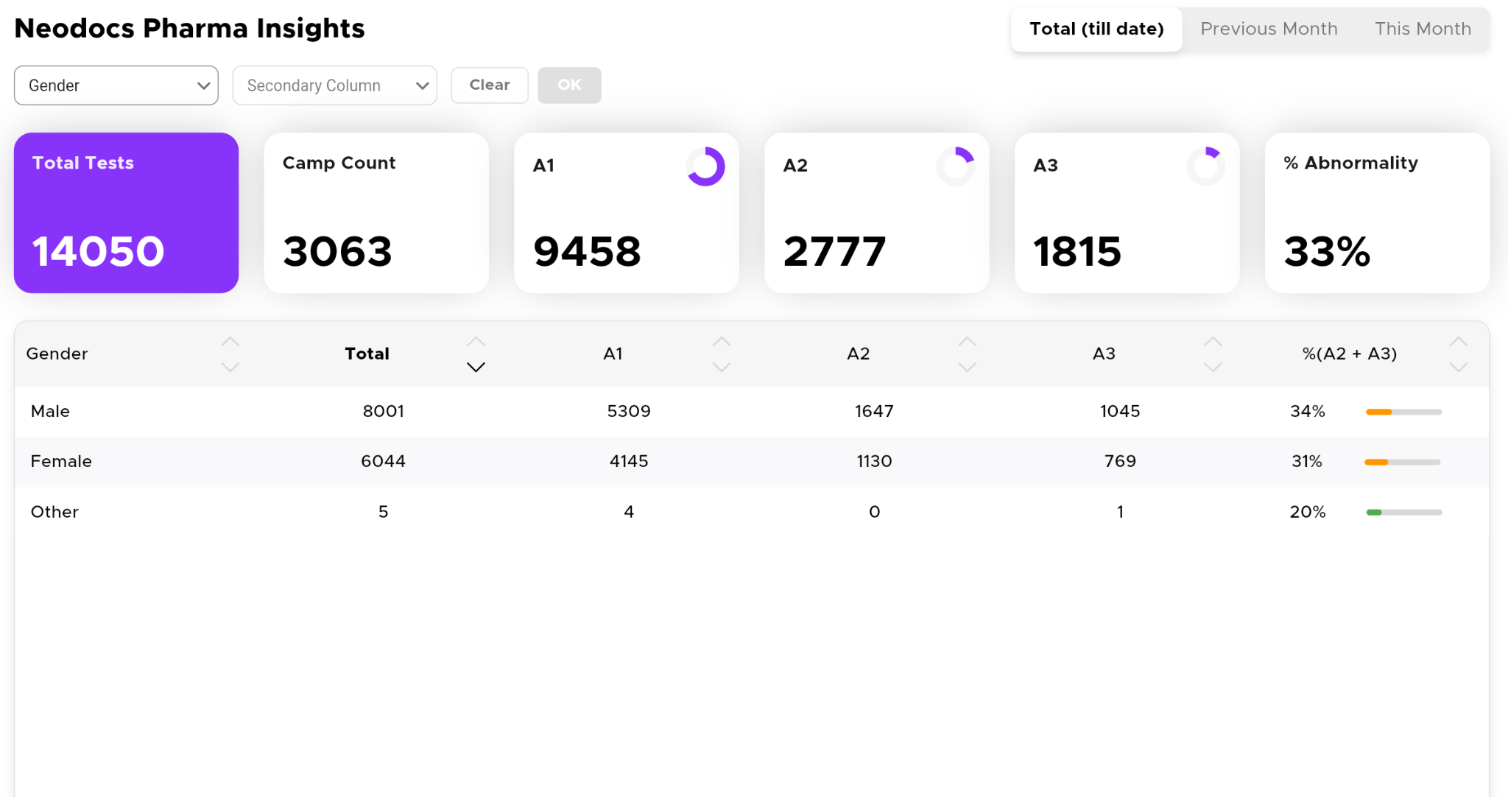
Gender Wise Overall insights (till 2nd July 2025)

Slide 8
June Month insights

Slide 9
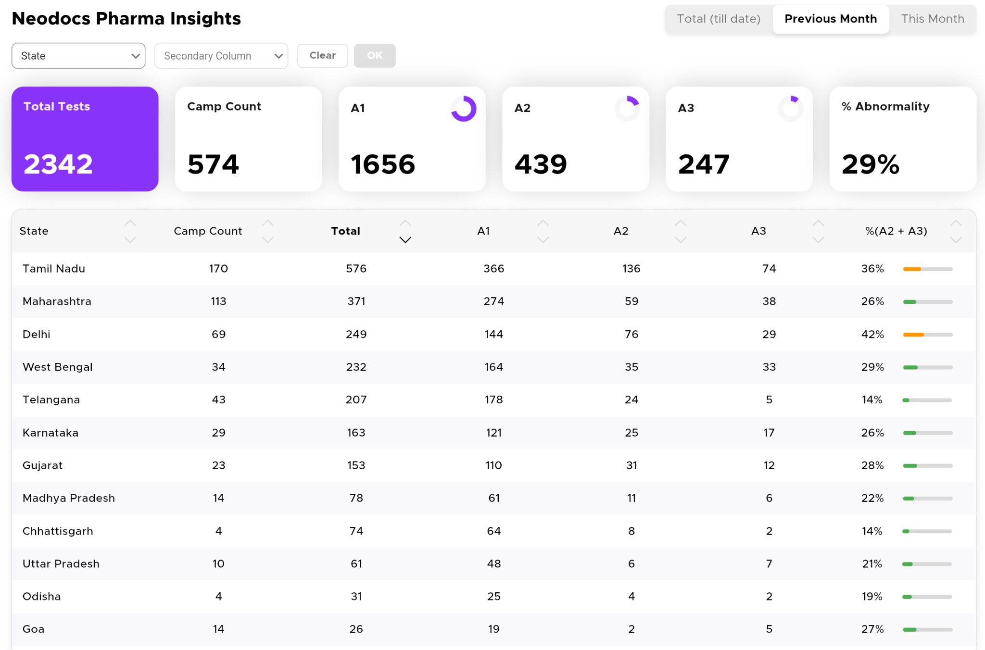
June month update - State wise Testing

Slide 10
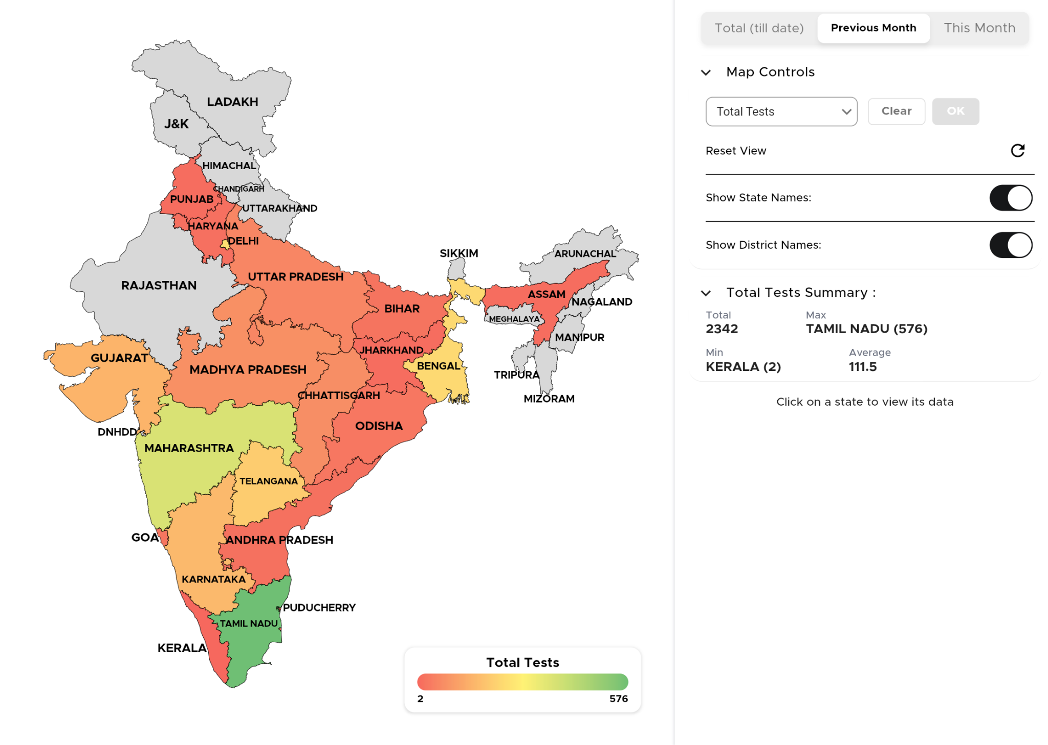
June month update - Map View

Slide 11
For more insights, login here:
https://ckddashboard.neodocs.in/

Slide 12
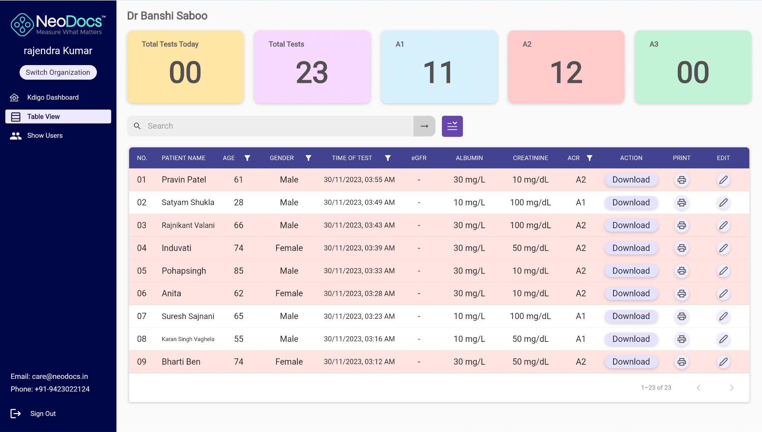
Doctor / Clinic Dashboard
Doctors can login on laptop / desktop for easy access
Can view, print and download report
Clinic level Kdigo Map
Clinic Users (doctor or staff) info
Multi-organization access function
Data filter by age, gender, date, ACR etc.
https://clinic.neodocs.in/

Slide 13
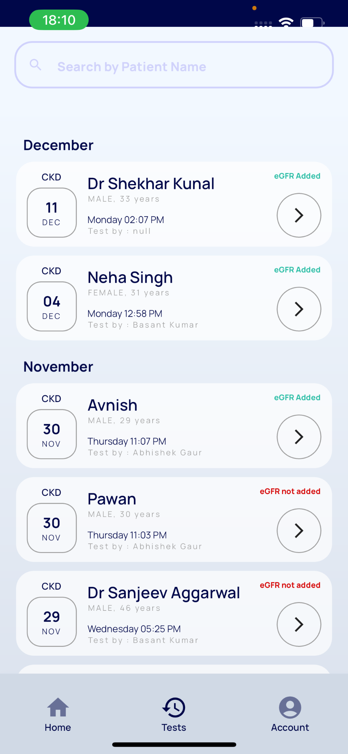
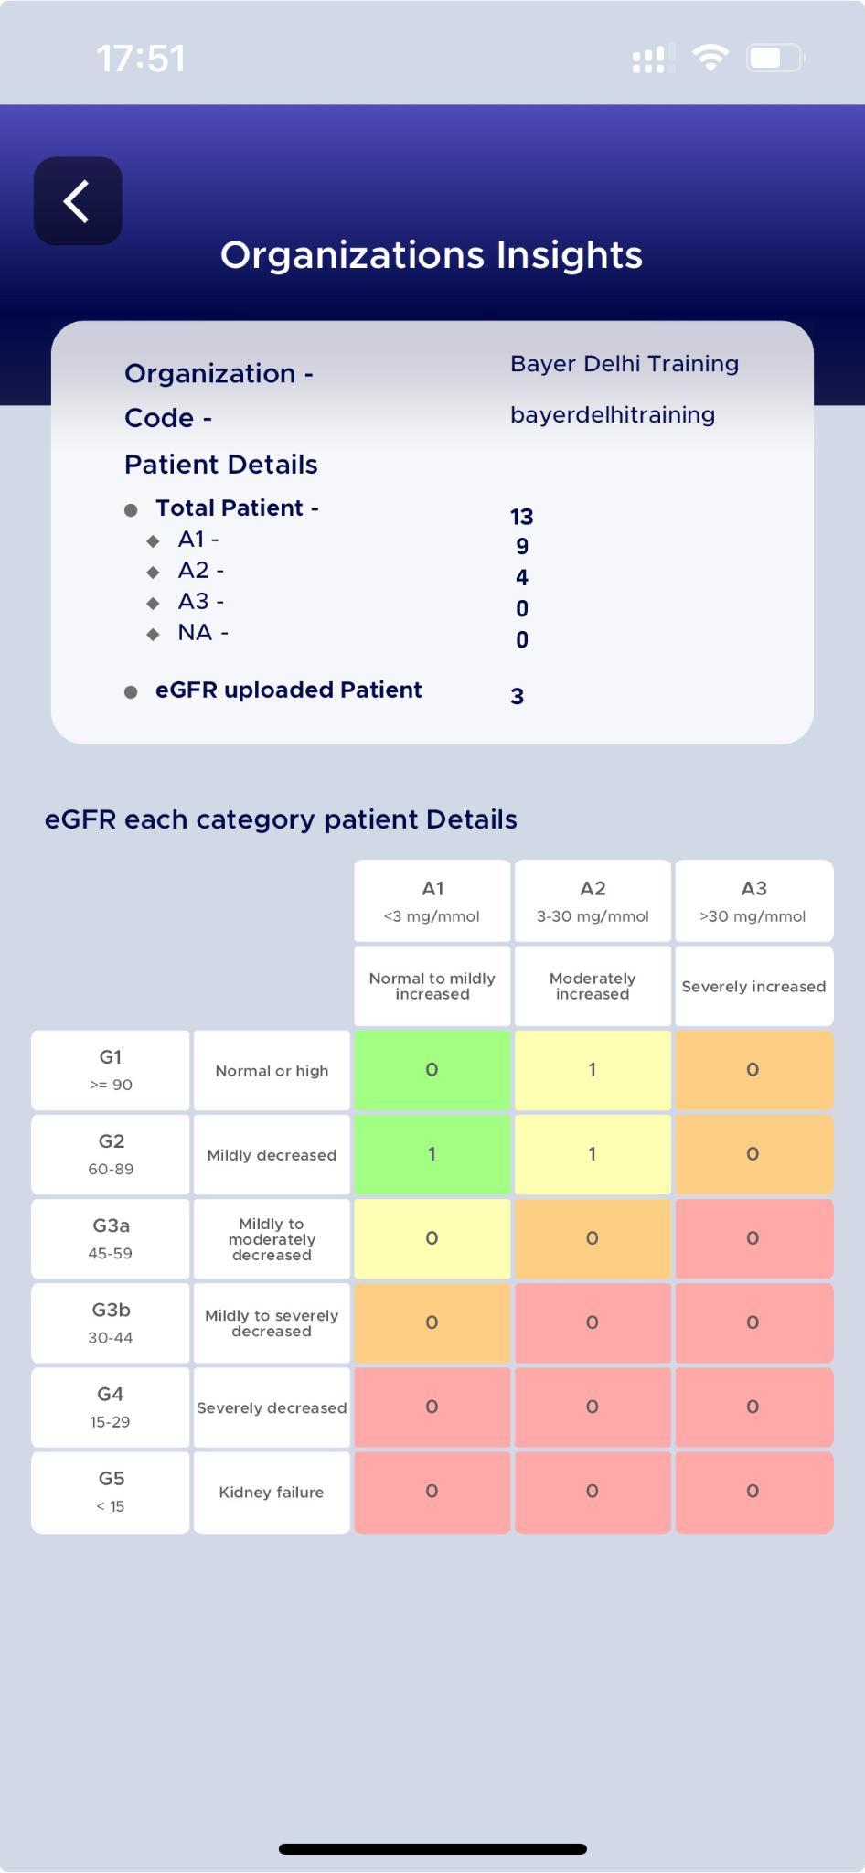
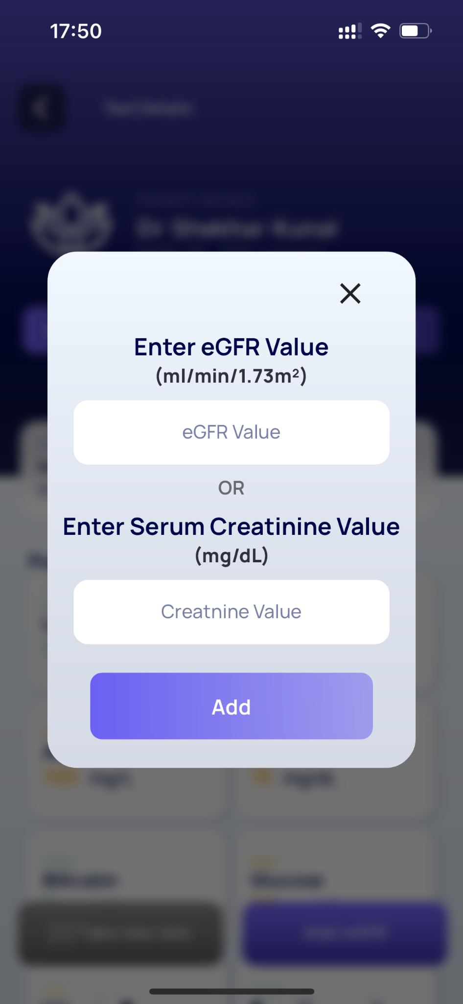
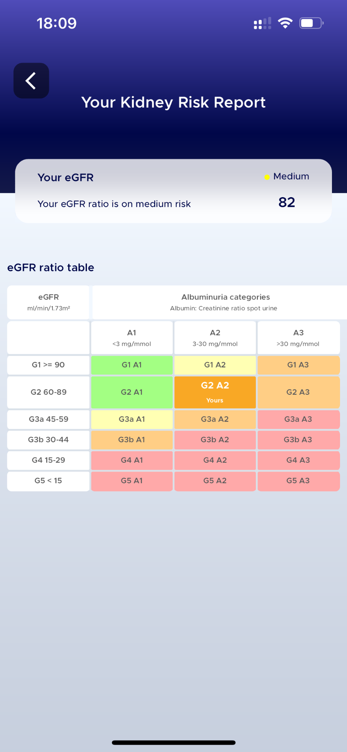
Features: Dr-NeoDocs App Dashboard

Slide 14
Thank you!
Contact Us:
Rajendra Bhaskar +91 99873 39111
Notes:
DON’T FORGET TO SET NEXT STEPS BEFORE LEAVING THE MEETING!

